Slide 1

Index Performance Tuning Through Pain Reduction
Find presentation, Excel spreadsheet, & T-SQL code at
https://github.com/SQLXL/SQLXL
Bill Sanscrainte
Bill@Sanscrainte.com
Notes:
*00:00*

Slide 2



Scan the QR code to submit session evaluations.

Slide 3






















SQL Saturday Baton Rouge 2024
Thank you, Sponsors!

Slide 4

About Me
Bill Sanscrainte linkedin.com/in/billsanscrainte Bill@Sanscrainte.com
SQL Server since 6.5
1984 - Executed first SQL statement leading first data warehouse project
1994 - Data Consulting practice
2001 - Version 1 of SQLXL tools
2020 - Retired to pursue SQL passion projects
Record holder for most SQL Cruises as a student SQL Server 10, Oracle 2

Slide 5

Agenda
Why are we here?
Client success story
Signs you should start with index tuning
New approach to index tuning
Where do we start?
What do we do?
Why are we doing it?
Free Stuff!
Questions?

Slide 6

Why are we here?
“Poorly designed indexes and a lack of indexes are primary sources of database application bottlenecks”
learn.microsoft.com 04/04/2023
Notes:
Indexes are primary sources of bottlenecks

Slide 7

Client Story - Once Upon a Time
Business: Membership & Event Management services
Application: has always been “slow” and getting “slower”
Problem: SQL Server “failed” when really busy
Notes:
PROBLEM:
SQL Server became non-responsive (DAC anyone?)
Restarted server
3 days to recover - untangle members, events, and payments
Lost several big customers

Slide 8

Client Story - Platform
AWS via “Lift & Shift” from on-premise
SQL 2016 Enterprise
32 cores 240GB RAM 2TB data
No SQL monitoring tools
Notes:
“CFO said the cloud would Save Big Money”

Slide 9

Signs You Should Start With Index Tuning - People
Original application designers are long gone
Designing code changes will take much longer
No developers available for code refactoring
Index changes can be done by others
No application testers available
Index changes affect speed not data
Client - 3/3
Notes:
02:00
When get called in begin asking questions to figure out where to start

Slide 10

Signs You Should Start With Index Tuning - Time & Money
No money for more bigger faster hardware
Index changes will work on existing hardware. May just take a little longer
Next activity peak can come at any time
Index changes can be done piecemeal, starting with highest priority
Maintenance Window already too big
With Enterprise Edition, index changes can be made online (no outage window)
Client - 6/6
Notes:
“NO” answer is bad

Slide 11
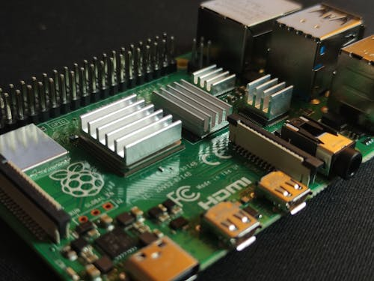
Signs You Should Start With Index Tuning - Technical Details
Poison Wait Types - RESOURCE_SEMAPHORE, THREADPOOL
As Memory & CPU use increases, less resource available for next query
“High” SOS_SCHEDULER_YIELD wait type
Long running query tasks shuffled from CPUs back to waiting queues
“High” Lock & Latch Waits
Too many indexes, lots of table and index scanning, lock escalations
Client 9/9
Notes:
05:00
YES answer is BAD
RESOURCE_SEMAPHORE - unable to get requested memory to execute query
THREADPOOL - no available threads in the server’s thread pool, CPU is MAX busy

Slide 12

Signs You Should Start With Index Tuning - Performance
CPU usage grows exponentially as users grow linearly
Query executions are getting in each others way
Indexes not tuned “recently”
Pretty much the universal condition. A key component of Database Technical Debt
Performance has been “fixed” by missing index recommendations or Data Tuning Advisor?
Leads to a lot of redundancy
Client 12/12
Notes:
05:00
YES answer is BAD

Slide 13
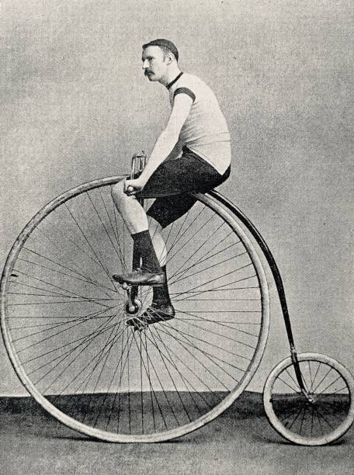
Getting Started Index Tuning - Legacy Approach
If you are lucky ☺ - your monitoring tool may have some answers
If not - lots of SQL community scripts available for download
Download & execute each script in SSMS, Azure Data Studio, DBeaver, …
Copy/paste each result set to spreadsheet(s)
Group related results by index and table
Line by line figure out what to do
Attempt to prioritize
Don’t forget “It Depends” factors
Create & run tuning scripts
Notes:
It depends - low usage index covering a foreign key

Slide 14
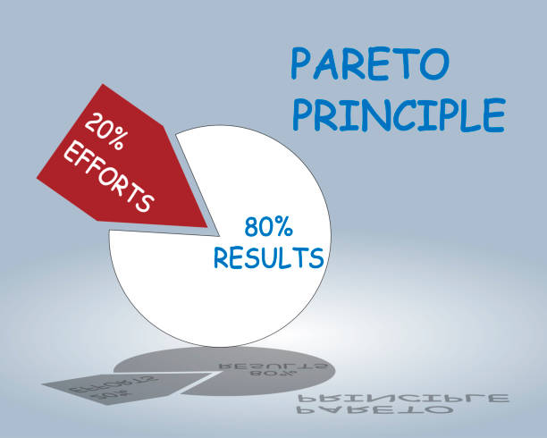
A New Approach to Index Tuning
Pareto’s Principle (or the “80/20 Rule”)
“80% of results from 20% of effort”
SQL Server tracks index “hurts”
Find the biggest hurts
Apply prescribed fixes
Notes:
*10:00*
HURT = Costs to Create, Read, Update, Delete (“CRUD”) data in tables

Slide 15

Client Story - Priority Findings
82% of hurt
4% of tables
Notes:
*22:00*
21 tables
Stunning insight - a lot less work to make significant improvement in performance
YMMV

Slide 16
Introducing SQLXL_Index - Demo
Where do we start?
Notes:
Nearly 260 columns
Dropdown
Hurts - 60 - color coded
*SORTS*
Table Name
Object Types
Hurt PCT - color coded

Slide 17
Performance Hurt - SQL Index Metrics
Waits Locks Page splits Page merges Missing indexes Total writes | Buffer usage Read / write ratio Index scans Table lookups Forwarded fetches LOB
Notes:
*08:00*
78 metrics of measured HURT
Lumped into 12 broad categories
INCOMPLETE - Fulltext, columnstore, in-memory
avg_system_impact
avg_total_system_cost
avg_total_user_cost
avg_user_impact
buffer_total_KB
column_value_pull_in_row_count
column_value_push_off_row_count
delete_buffer_scan_count
forwarded_fetch_count
index_lock_promotion_attempt_count
index_lock_promotion_count
index_scan_count
in_row_reserved_page_count
io_wait_time_in_ms
key_merge_count
key_merge_retry_count
key_split_count
key_split_retry_count
leaf_allocation_count
leaf_delete_count
leaf_ghost_count
leaf_insert_count
leaf_page_merge_count
leaf_update_count
lob_fetch_in_pages
lob_orphan_create_count
lob_orphan_insert_count
lob_reserved_page_count
new_log_wait_time_in_ms
nonleaf_allocation_count
nonleaf_delete_count
nonleaf_insert_count
nonleaf_page_merge_count
nonleaf_update_count
page_consolidation_count
page_consolidation_retry_count
page_io_latch_wait_count
page_io_latch_wait_in_ms
page_latch_wait_count
page_latch_wait_in_ms
page_lock_count
page_lock_wait_count
page_lock_wait_in_ms
page_merge_count
page_merge_retry_count
page_split_count
page_split_retry_count
page_update_count
page_update_retry_count
range_scan_count
reserved_page_count
row_delete_attempts
row_group_lock_count
row_group_lock_wait_count
row_group_lock_wait_in_ms
row_insert_attempts
row_lock_count
row_lock_wait_count
row_lock_wait_in_ms
row_overflow_fetch_in_pages
row_overflow_reserved_page_count
row_update_attempts
singleton_lookup_count
system_lookups
system_scans
system_seeks
total_wait_time_in_ms
tree_page_io_latch_wait_count
tree_page_io_latch_wait_in_ms
tree_page_latch_wait_count
tree_page_latch_wait_in_ms
unique_constraint_violations
user_lookups
user_scans
user_seeks
waits_for_io_count
waits_for_new_log_count
write_conflicts

Slide 18

Performance Hurt
Waits
Locks
Splits
Merges
Missing
Writes
Buffer
Read/Write
Scans
Lookups
Fetches
LOB
Requested index action waited for another SQL activity to complete
Measure: counts & time waiting on:
Hurt: longer execution time
locks | rowstore “logical” buffer cache actions
latches | rowstore “physical” actions memory <-> disk
row groups | columnstore actions
I/O, logs | in-memory OLTP actions
Notes:
08:30

Slide 19

Performance Hurt
Waits
Locks
Splits
Merges
Missing
Writes
Buffer
Read/Write
Scans
Lookups
Fetches
LOB
Controls for transactional compliance with ACID requirements
Measure: counts
rowstore locks applied to pages, rows
rowstore lock promotions (row -> page -> partition -> table)
attempts, successes
fails = attempts - successes
columnstore locks
Hurt:
longer execution time
more lock memory & I/O
Notes:
09:00
ACID - atomicity, consistency, isolation, durability

Slide 20

Performance Hurt
Waits
Locks
Splits
Merges
Missing
Writes
Buffer
Read/Write
Scans
Lookups
Fetches
LOB
Can’t fit inserted / updated data into an existing data page
creates new page
splinters data between both pages
Measure: counts
index leaf & tree splits
LOBs pushed off-row
in-memory page & key splits
Hurt:
more I/O
more CPU
Notes:
09:30
column_value_push_off_row = to LOB storage

Slide 21

Performance Hurt
Waits
Locks
Splits
Merges
Missing
Writes
Buffer
Read/Write
Scans
Lookups
Fetches
LOB
Row deletion or column update frees up space
squeeze data pages together
emptied pages marked for cleanup
Measure: counts
index leaf & tree merges
LOBs pulled in-row
in-memory page & key merges
Hurt:
more I/O
more CPU
Notes:
10:00
column_value_pull_in_row = from LOB storage

Slide 22

Performance Hurt
Waits
Locks
Splits
Merges
Missing
Writes
Buffer
Read/Write
Scans
Lookups
Fetches
LOB
Suggestions from the SQL optimizer to improve a single query
Measure:
Count of executions
Query cost estimate
Estimated query cost savings
Hurt:
inefficient query execution
more I/O
more CPU
less available buffer cache
NOTE: comes with many limitations
Notes:
10:30

Slide 23

Missing Index Limitations (from Microsoft)
Only considers nonclustered, rowstore, disk-based indexes
No clustered, columnstore, XML, spatial, full-text, hash, unique, filtered, materialized views …
Uses estimates from first optimization of a single query
Cleared for a table on DDL change or rebuild
First 600 only, any more ignored
Suggested index key columns listed by table column creation order, not selectivity
No consideration for key column parameter sniffing
Query metrics are not updated after actual execution(s)
Not weighted based on total number of times table was accessed
Ignores internal tables (e.g. supporting full text & spatial indexes)
Ignores history tables (CDC, SVN, LDG)
Adds included columns to cover query, without weighing cost / benefit ratio
No understanding of existing indexes or previous recommendations - causes overlaps!
No suggestions for trivial query plans
Suggests missing index for imprecise and non-persisted computed columns
Only one returned from each query, even if several were suggested in plan XML
Queries with inequality predicates only have less accurate query cost
Does not consider existing nonclustered columnstore in deciding on a “missing” index
Notes:
11:00

Slide 24

Performance Hurt
Waits
Locks
Splits
Merges
Missing
Writes
Buffer
Read/Write
Scans
Lookups
Fetches
LOB
Changes to table & index data
Measure: counts
inserts
updates
deletes
Hurt:
more I/O
more locking
Notes:
11:30
Operations - number of times index touched, e.g. Loop Join

Slide 25

Performance Hurt
Waits
Locks
Splits
Merges
Missing
Writes
Buffer
Read/Write
Scans
Lookups
Fetches
LOB
Proportion of index/heap in the buffer cache
exclude in-memory objects (always 100%)
Weighted by size of table + indexes
Measure:
pages in memory total reserved pages allocated
Hurt:
more I/O - physical reads
less memory available for queries and data cache
Notes:
12:00

Slide 26

Performance Hurt
Waits
Locks
Splits
Merges
Missing
Writes
Buffer
Read/Write
Scans
Lookups
Fetches
LOB
“Gooder” indexes are read way way more than written
Benchmark: read > 4X writes because writes cost more:
Transaction Locks & Exclusive Latches
Uniquifiers/RIDs (Row IDentifiers)
Sequence/identity generation
Splits & merges
Deletes & Ghost cleanup
Log file I/O
Data file I/O
Change/History Table inserts
Replica synching
Measure: count of reads / writes
Hurt: much pain for little gain
Notes:
12:30

Slide 27
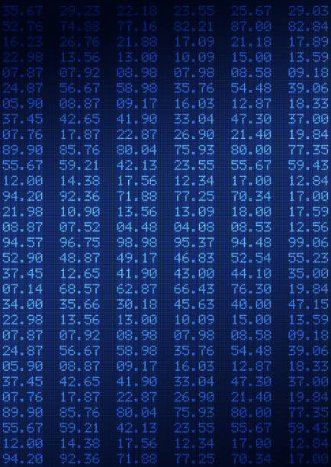
Performance Hurt
Waits
Locks
Splits
Merges
Missing
Writes
Buffer
Read/Write
Scans
Lookups
Fetches
LOB
Start at the top and read all pages
until you hit bottom
or TOP (###)
if index keys match ORDER BY
Measure:
count of row-store range scans
Columnstore index is scan only
Hurt:
more I/O
less memory available for queries and data cache
Notes:
13:00
“Better” indexes get ”Seeked” - still may involve scan from that point
Or TOP (###) - if index keys match ORDER BY columns

Slide 28

Performance Hurt
Waits
Locks
Splits
Merges
Missing
Writes
Buffer
Read/Write
Scans
Lookups
Fetches
LOB
Index keys & included columns don’t “cover” query needs
extra seek(s) to data row
Measure: count of Lookups
Hurt:
more I/O
more locking
Notes:
13:30
“Better” indexes get ”Seeked” - still may involve scan from that point

Slide 29

Performance Hurt
Waits
Locks
Splits
Merges
Missing
Writes
Buffer
Read/Write
Scans
Lookups
Fetches
LOB
Heap Table - updating record causes page split
data physically moved out of original insertion sequence
pointers created to maintain data order
Measure: count of forward fetched rows
Hurt:
more I/O - additional read(s) required to follow forwarding record pointer to moved page
more locking
Notes:
14:00
corrected by creating clustered index -or- table rebuild

Slide 30

Performance Hurt
Waits
Locks
Splits
Merges
Missing
Writes
Buffer
Read/Write
Scans
Lookups
Fetches
LOB
Big data types
TEXT, NTEXT
IMAGE
VARCHAR(MAX), NVARCHAR(MAX)
VARBINARY(MAX)
XML
Maintained in off-row pages
separate data allocation units
extra maintenance for pointers
Measure: count of LOB inserts, updates, deletes, selects
Hurt: more I/O
Notes:
*10:00*
Special data allocations: LOB_DATA & ROW_OVERFLOW_DATA

Slide 31

Weighting the Hurt - Current Defaults*
Waits ++++++
Locks +++
Splits +++++
Merges +++++
Missing ++++
Writes +++
Buffer +++++
Read/write ++++
Scans ++++
Lookups ++
Fetches +++
LOB +
* Runtime parameters
Notes:
13:00
Parameterized in SQLXL_Index
19 different values
Reflect your server’s operational metrics
Aggregated to Table level
<BS> Reads don’t include index seeks!

Slide 32
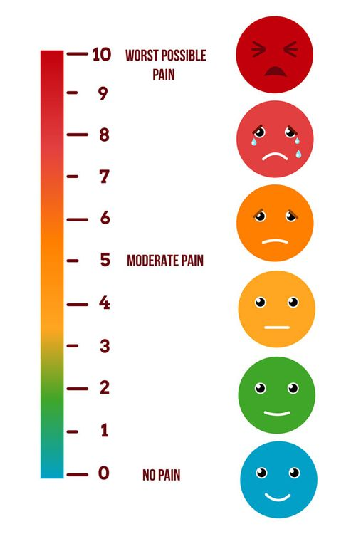
Prioritizing Hurt
For each hurt metric
Total by table
Total by instance (or single database)
Compute table’s percent of instance total
Apply hurt weighting factor
Total up all weighted metrics by table
Present results in descending order of hurt
Notes:
20:00
60 hurt metrics
Why by table - it’s where the data lives

Slide 33

Client Story - Priority Actions
The 21 (4%) high priority tables make sense, but …
What do we do to make the hurt go away?

Slide 34
SQLXL_Index Demo
What do we do?

Slide 35

SQLXL_Index - Prescriptions
100+ table and index-level prescriptions
Grouped into 8 action categories
Notes:
*24:00*
What are the 8 things you can do the indexes on a table?

Slide 36
SQLXL_Index - Prescriptions
Retain Replace Request Reject | Remove Review Refresh Refactor
Notes:
28:00

Slide 37
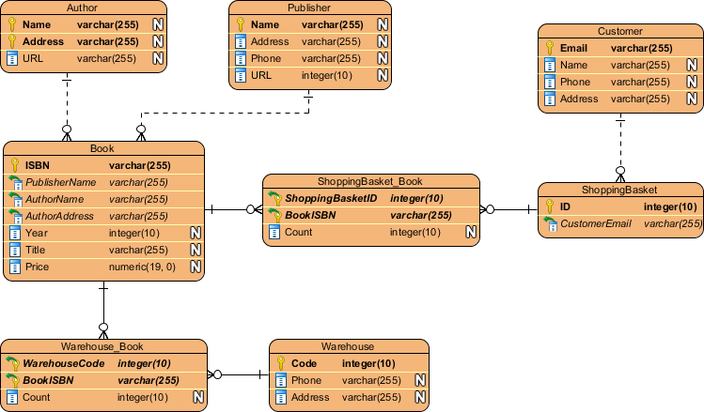
Prescription Categories
Retain
Replace
Request
Reject
Remove
Review
Refresh
Refactor
Existing indexes “As Architected & Designed”
Clustered
Constraints - primary key, unique, foreign key
Index covering foreign key constraint (exec parameter)
Specials - in-memory, full-text, spatial, XML, columnstore
History - Change Data Capture, System Versioned, Ledger
Internal Tables
Required by others
e.g. unique index supporting full-text index
Notes:
Purpose built indexes

Slide 38

Prescription Categories
Retain
Replace
Request
Reject
Remove
Review
Refresh
Refactor
New feature in SQL 2016+ Enterprise updatable nonclustered columnstore
Replace existing nonclustered rowstore indexes
Low usage
Low read/write ratio
Alternative for missing indexes

Slide 39

Prescription Categories
Retain
Replace
Request
Reject
Remove
Review
Refresh
Refactor
Create New Index
Clustered indexes on used heaps
Covers for foreign key constraints (exec parameter)
Valuable missing indexes
Updatable nonclustered columnstores (SQL 2016E+)

Slide 40

Prescription Categories
Retain
Replace
Request
Reject
Remove
Review
Refresh
Refactor
Missing index recommendations
That don’t add significant value
Table has / will have nonclustered columnstore (parameter)
Notes:
Especially once weighted by share of reads

Slide 41

Prescription Categories
Retain
Replace
Request
Reject
Remove
Review
Refresh
Refactor
Existing indexes
Cost more than benefit - less than 4 reads per write
Duplicate - Least used
Redundant foreign key constraint
Notes:
Same keys different sequence (“overlap”)
Keys “contained” in another bigger index

Slide 42

Prescription Categories
Retain
Replace
Request
Reject
Remove
Review
Refresh
Refactor
“It Depends” for indexes tagged previously - such as:
Potential filtered index - wide range of rows per lead index key
Non-persisted computed column in index
Potential temporary based on name
High page compression failures
Synergies & overlaps
Disabled

Slide 43

Prescription Categories
Retain
Replace
Request
Reject
Remove
Review
Refresh
Refactor
Statistics on indexes with
Stats row modifications
Stats row count not matching table row count
Rebuild/organize columnstores
delta stores (update, delete)

Slide 44

Prescription Categories
Retain
Replace
Request
Reject
Remove
Review
Refresh
Refactor
Retained indexes benefiting from structural changes like:
Clustered rowstore index not “NUSE”
Narrow, Unique, Static, Ever increasing
Rowstore index - additional key(s) don’t improve selectivity
FILL FACTOR = 100% and hi page splits
Index partition not match table partition
Collation mismatch
Page / row locking not enabled
Notes:
BEFORE MOVING ON – show more examples?

Slide 45

Client Story - Priority Prescription Implementation
Disable index and statistics maintenance jobs
Build “prior week” baseline after weekly maintenance restart
Apply prescriptions to 4% of tables (21)
Restart server after weekly maintenance
Capture next weeks statistics
Compare week over week results
Note: “mostly similar” non-peak workloads
Notes:
37:00
Fixes applied & server restarted

Slide 46

Client Story - SQL Wait Improvements versus Previous Week
RESOURCE_SEMAPHORE -71%
THREADPOOL -67%
SOS_SCHEDULER_YIELD -63%
LCK_* & PAGELATCH_* -52%
Notes:
YMMV

Slide 47

Client Story - Index Hurt Improvements versus Previous Week
Waits - times & counts -77%
Locks - count, promotions -62%
Scans & lookups -58%
Read / Write ratio -47%
Writes -43%
Splits, merges, push off / pull in -39%
Buffer cache usage - 0%
Notes:
Fixes applied & server restarted

Slide 48

SQLXL_Index - Building the Prescriptions
Capture the raw ingredients
89 DMVs & DMFs, 925 columns
238 configurations
182 performance & hurt metrics
38 seconds to:
Collect
Diagnose
Prescribe
Prioritize
Note: many index metrics reset on:
Server restart
Index rebuild & reorg
Table or index refactor
Notes:
40:00
How did we come up with prescriptions? We diagnosed the symptoms.

Slide 49

SQLXL_Index Metadata & Metric Sources
Server Database=> @@ Functions DBCC TRACESTATUS sys.availability_replicas sys.change_tracking_databases sys.database_scoped_configurations sys.databases sys.dm_db_index_operational_stats sys.dm_db_index_usage_stats sys.dm_db_missing_index_columns sys.dm_db_missing_index_details sys.dm_db_missing_index_group_stats sys.dm_db_missing_index_group_stats_query sys.dm_db_missing_index_groups sys.dm_exec_query_plan sys.dm_exec_query_stats sys.dm_exec_sessions sys.dm_exec_sql_text sys.dm_hadr_availability_replica_states sys.dm_os_buffer_descriptors sys.dm_os_sys_info SERVERPROPERTY Function | cdc.change_table sys.allocation_units sys.change_tracking_tables sys.check_constraints sys.column_store_row_groups sys.column_type_usages sys.columns sys.computed_columns sys.data_spaces sys.database_automatic_tuning_options sys.database_files sys.database_query_store_options sys.database_scoped_configurations sys.default_constraints sys.dm_db_column_store_row_group_operational_stats sys.dm_db_column_store_row_groups sys.dm_db_column_store_row_group_physical_stats sys.dm_db_incremental_stats_properties sys.dm_db_partition_stats sys.dm_db_stats_properties sys.dm_db_xtp_hash_index_stats sys.dm_db_xtp_index_stats sys.dm_db_xtp_memory_consumers sys.dm_db_xtp_Nonclustered_index_stats sys.dm_db_xtp_object_stats sys.dm_db_xtp_table_memory_stats sys.dm_sql_referencing_entities sys.dm_xtp_system_memory_consumers sys.edge_constraint_clauses sys.edge_constraints sys.extended_properties sys.filegroups sys.foreign_key_columns sys.foreign_keys | sys.fulltext_catalogs sys.fulltext_index_columns sys.fulltext_indexes sys.hash_indexes sys.identity_columns sys.index_columns sys.index_resumable_operations sys.indexes sys.internal_partitions sys.internal_tables sys.key_constraints sys.objects sys.partition_functions sys.partition_schemes sys.partitions sys.schemas sys.sequences sys.spatial_index_tessellations sys.spatial_indexes sys.sql_expression_dependencies sys.sql_modules sys.stats sys.stats_columns sys.table_types sys.tables sys.triggers sys.types sys.views sys.xml_indexes sys.xtp_memory_consumers sys.xtp_nonclustered_index_stats sys.xtp_object_stats

Slide 50

SQLXL_Index - 476 Diagnostics (SQL version aware)
“Good to know” - like
Dates: Last read / written / modified / created / statistics updated …
“Key” configuration properties
server, instance, database, query store …
Items that “stand out” - like
Non-default properties, settings, parameters
High proportion of a hurt or other metric
e.g. waits, locks, splits, merges
Anti-Patterns - like
Big included columns
Uncovered foreign keys
with missing index recommendations
Link to Brent Ozar’s sp_BlitzIndex “Checks” (58)
Notes:
*41:00*
Non-Default - Cost threshold for Parallelism
History and Internal Tables given a pass (mostly)
Version Aware - don’t ding SQL 2012 for new feature in SQL 2022
Link to BlitzIndex when same item found (58 items)

Slide 51
SQLXL_Index - Demo
Why are we doing it? Diagnostics!
Notes:
Squeeze! Into smallest possible space
Avoid scrolling

Slide 52

What about Index Metadata and Other Metrics?
It’s in the spreadsheet
257 columns - details on
Foreign key constraints
Table & column constraints
Statistics names and filter definitions
Extended properties
All usage metrics
All Operational metrics
including in-memory & columnstores
Metadata - index, table, database, instance
Notes:
45:00

Slide 53
SQLXL_Index Demo
Show me the Metadata!
Notes:
** SWITCH TO METADATA **

Slide 54

Implementing Index Fixes - Preparation
Clone structure of target database
Apply changes to clone to produce prescribed “end state”
Create delta scripts using favorite DDL comparison tool: target -> ”end state”
Scripting DDL changes best left to “experts”
Create “rollback code” by comparing in the opposite direction
Plan for lots of log file
Use Incrementalism
Consider DISABLE before dropping
Check index usage on secondary before dropping!
Notes:
48:00
Depending on where problem occurs at what stage in the process, rollback code may be incomplete
Many DDL comparison tools batch up all related activities - can be difficult to unwind if failure

Slide 55

Implementing Index Fixes - Application
Apply delta scripts to target database
Re-compare “end state” to target database
Address any discrepancies
Execute rollback code if SHTF
*IMPORTANT* Batch changes by table
More time to script & execute
Expedites (inevitable) rollbacks
Notes:
*50:00*
Depending on where problem occurs at what stage in the process, rollback code may be incomplete
Many DDL comparison tools batch up all related activities - can be difficult to unwind if failure

Slide 56

Client Story - They Lived Happily Ever After
Good News - Even bigger event SQL CPU max 32%, no issues reported
Even more better - No performance complaints!
Completed most of the remaining index prescriptions, including:
Replace least-used indexes with nonclustered columnstores
Remove indexes not adding value
Request high-value missing indexes, heap clustered indexes, foreign key covers
Notes:
50:00

Slide 57

Free Stuff!
All T-SQL code, Excel workbook, & this presentation on Github
Up to 8 hours free consulting!
Notes:
52:30

Slide 58

Looking for Volunteers to help improve SQLXL_Index
Identify edge cases
Bug hunts & error handling
Tables - history (CDC, SVN, LDG), graph, internal
Azure - SQL Database, SQL Managed Instance
Special indexes - XML, full-text, spatial, hash
SQL table valued functions (TVF)
Additional execution parameters
Labeling, cell comments, and navigation
Documentation (what’s that?)
Operations
Notes:
52:30

Slide 59

Summary
Tuning indexes is a likely starting point for improving performance
SQL Server lets us know where to concentrate our efforts
Prioritize your index tuning - biggest bang for smallest buck
Actionable prescriptions make tuning decisions simpler
Incremental changes can minimize unforeseen outcomes
You can help improve SQLX_Index!
Notes:
53:30

Slide 60

Special thanks to these and other SQL community contributors!
Brent Ozar Kevin Kline Jes Borland Tom Collins Erik Darling Glenn Berry Gail Shaw Pedro Lopes Dave Bland | Tim Ford Sean McCown Kendra Little Pinal Dave Phil Factor Kalen Delaney Jason Strate Jared Westover Percy Reyes | Grant Fritchey Andy Yun Paul Randall Kimberly Tripp Edward Pollack Ahmad Yaseen Evgeniy Gribkov Ola Hallengren Denny Cherry | Aaron Bertrand Jonathan Kehayias Dmitri Korotkevitch Niko Neugebauer Monica Rathbun Kendall vanDyke Thomas LaRock Torsten Strauß Rebecca Hirschfield
Notes:
Shout out to these and others whose community contributions went into this presentation
Future Adds:
Jared Westover
Pedro Lopes (MS)

Slide 61

Questions?
Notes:
*54:00*
Questions?

Slide 62

Please fill out the Session Evaluation!
Notes:
*59:00*
Session Evaluations

Slide 63

Thanks for coming!
Bill Sanscrainte
linkedin.com/in/billsanscrainte & Bill@Sanscrainte.com
Presentation, spreadsheet, & T-SQL @ https://github.com/SQLXL/SQLXL
Also See:
Brent Ozar’s sp_BlitzIndex
Glenn Berry’s 89 (2022) Diagnostic Information Queries
Aaron Bertrand’s 40 table property queries
Expert Performance Indexing in Azure SQL and SQL Server 2022 (Great Book!)
Link to sp_Blitz_Index Checks:
https://github.com/BrentOzarULTD/SQL-Server-First-Responder-Kit/blob/dev/Documentation/sp_BlitzIndex_Checks_by_Priority.md
Notes:
59:30

Slide 65
Notes:
Sample Data - Microsoft’s WideWorldImporters
Run SQLXL_Index
Display in Excel - Automagically transferred to Excel via macros and ADODB connection
Dropdown - select columns displayed- 258 columns at last count
Out of 60 - 24 principal table hurt metrics, computed as percent of instance/database
For each table
Columns highlighted “good” green to “bad” red
not all good or all bad

Slide 66

Notes:
Sample Data - Microsoft’s WideWorldImporters_FULL
OrderLines is 30% wait time 8% wait count - fewer longer

Slide 67
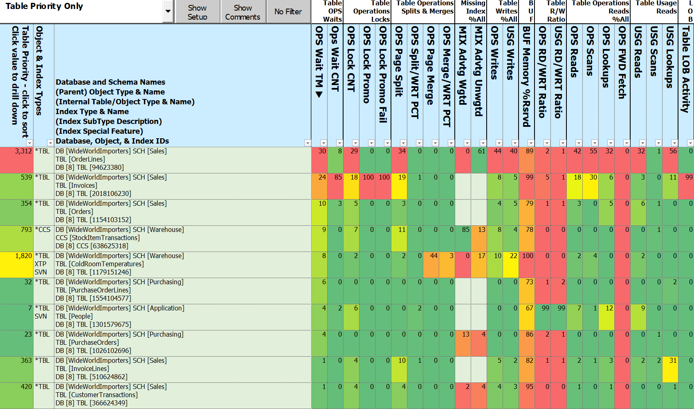
Notes:
So hurt can be spread unevenly across the pain metrics
Invoices is 24% wait time 85% wait count - more shorter

Slide 68
Notes:
Dashboard
Getting to the Action
Click on Table Level priority
Display changes to Index details

Slide 69
Notes:
SAMPLE DATA
Sorted by index type, Foreign Key, Missing Indexes, History tables, Internal Tables
Sorting available on column heads
Enable Optimize for Sequential key new in 2019

Slide 70
Notes:
Optimize for Sequential Key - New in 2019, “can” speed up inserts into tables with identity or sequence clustered index

Slide 71
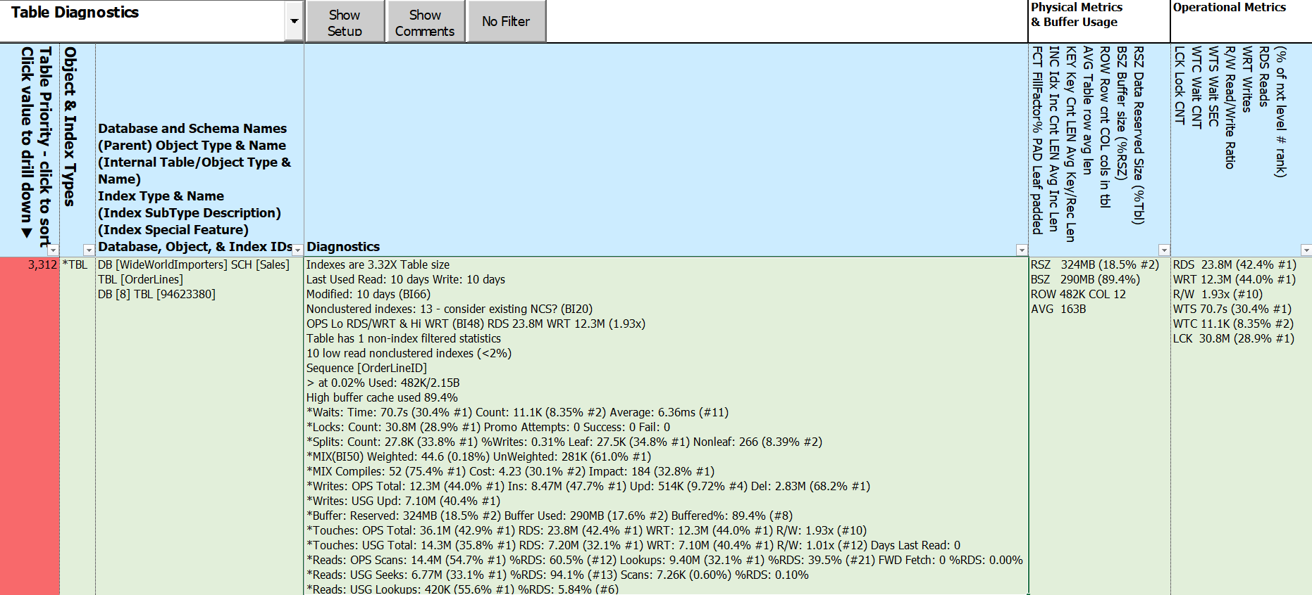
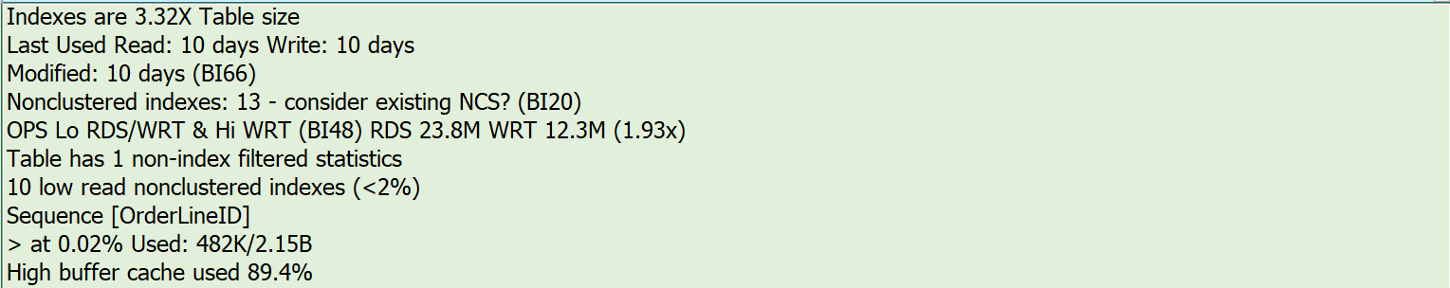
Notes:
Diagnostics split into 2 elements
Things to know
High pain metrics and related values - top values only
Trying to eliminate scrolling to “see” all of the key information
BlitzIndex Checks (BI##)

Slide 72
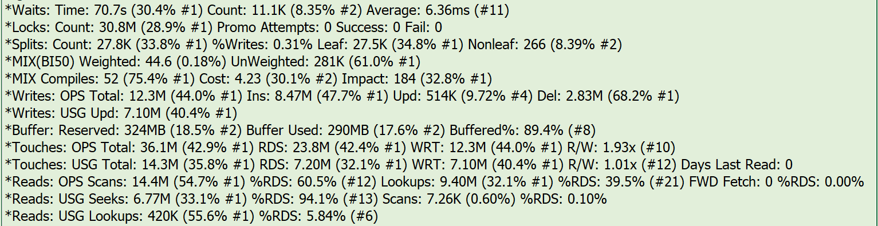
Notes:
Hurts & related metrics
3 elements per hurt - metric type, metric total, percent instance, ranking

Slide 73
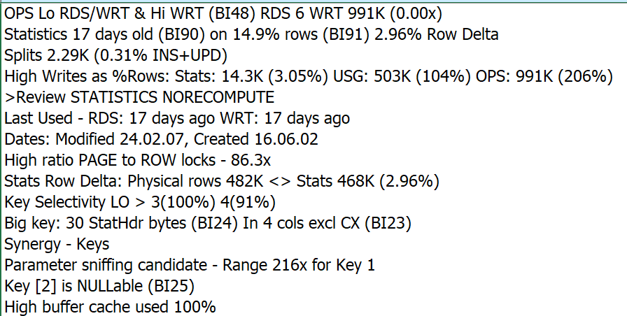
Notes:
Nonclustered Rowstore
To be replaced by existing NCS
BlitzIndex Checks (BI##)

Slide 74
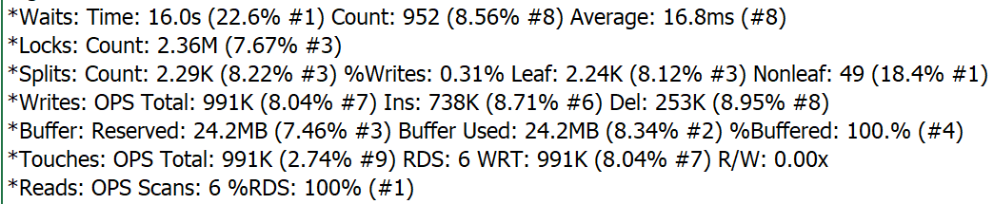
Notes:
Selected priority columns

Slide 75
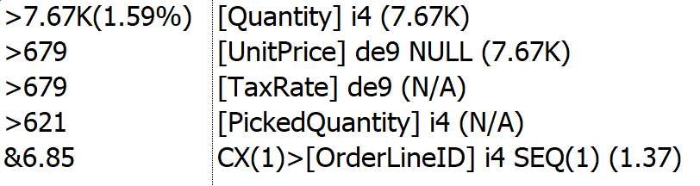
0.00%
- 8.54%

Slide 76
